Slide 1
Week 2 – Dynamic array
Team “Encoder”
Oleksandr Kuprii
Illia Kara

Slide 2
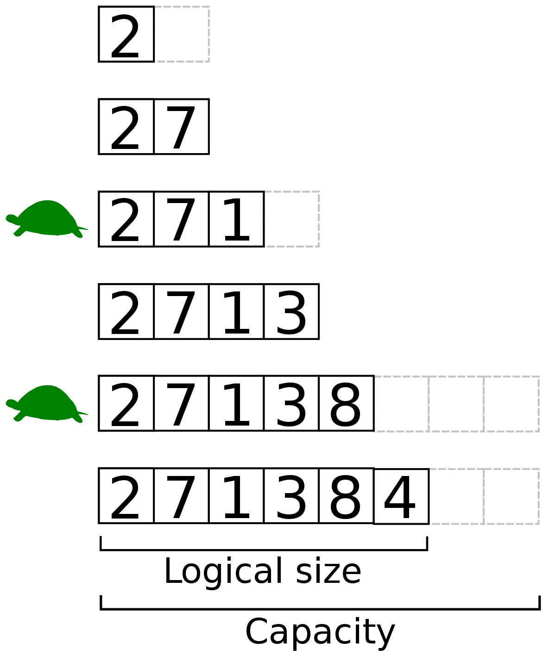
What we have learnt
We have learnt how to implement dynamic array

Slide 3
SURprises
The early morning of the Thursday on the 24th of February

Slide 4
Problems
The ruthless war in Ukraine
The difficulty to work efficiently in this period

Slide 5
Still unclear
… pointers

